Slide 1
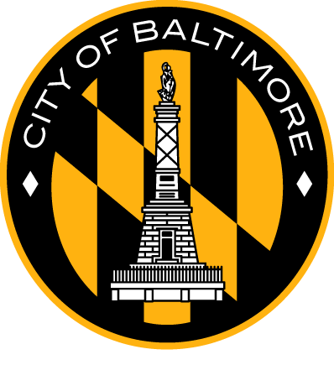

Battle of Neighborhoods
Baltimore

Slide 2
Problem Statement
Segment by areas the city of Baltimore by the type of food that people prefer in the area
Be able to detect which areas of the city are more problematic or dangerous

Slide 3
Objective
Obtain information on incidents that occurred in the city of Baltimore through the OPEN BALTIMORE API
Collect the main restaurants by neighborhood that people most frequent with the use of the Foursquare API (Beautiful Soup, http request)
Forming neighborhood clusters based on the categories of the restaurants using unsupervised k-mean clustering algorithm (sklearn)

Slide 4
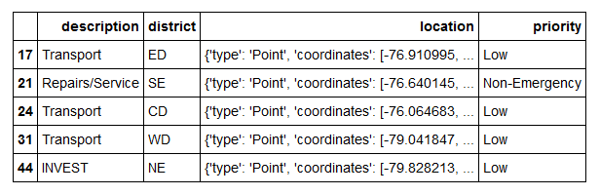
Work flow Incidents
Collect incident of Baltimore
https://data.baltimorecity.gov/
Graph the map with information
Group incidents by neighborhood
Identify in which neighborhood the incident occurred

Slide 5
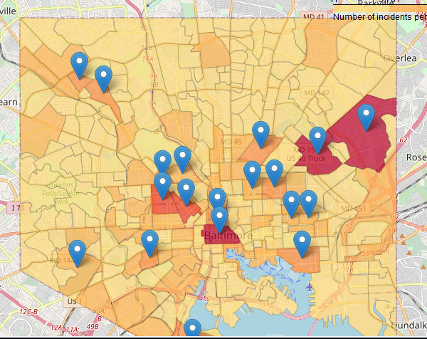
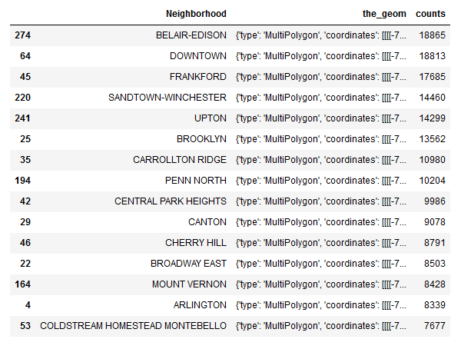
The most dangerous neighborhoods in Baltimore

Slide 6
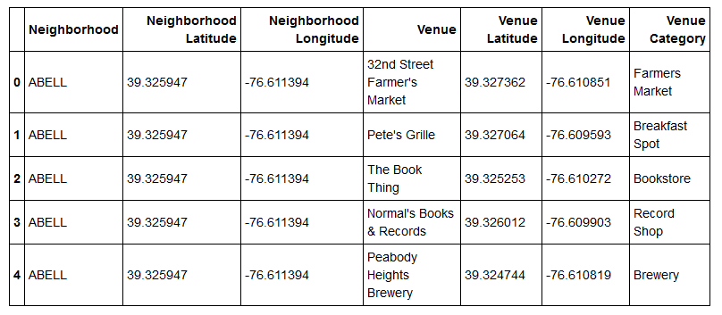
Work flow restaurants
Collect venues of Baltimore
https://foursquare.com/developers/apps
Create the cluster algorithm
We get restaurant frequencies by neighborhood
We filter information only from restaurants

Slide 7
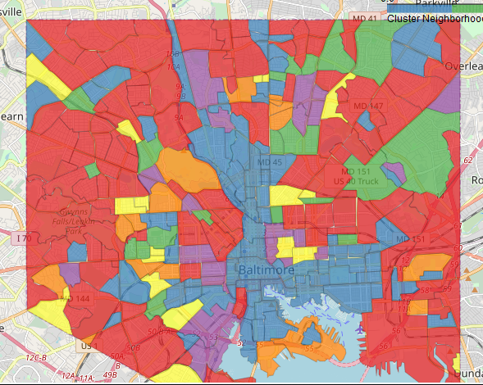
Map of clusters

Slide 8
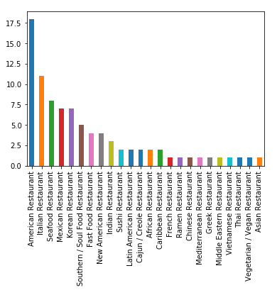
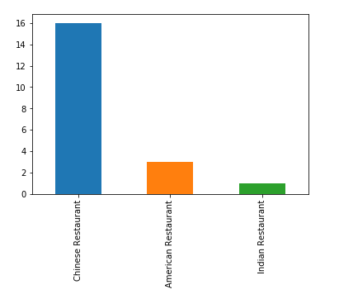
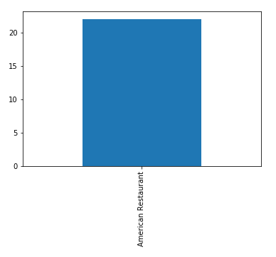
Frequencies of cluster
1
2
3

Slide 9
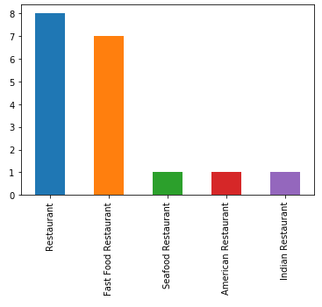
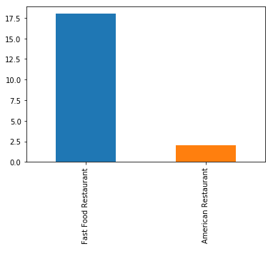
Frequencies of cluster
4
5

Slide 10
Conclusion
We can see that the cluster 1 with 87 Neighborhoods, the first option to eat is in an American Restaurant, the cluster 2 with 20 Neighborhoods prefer a Chines Restaurant like first option, Cluster 3 with 22 Neighborhoods his first and only opcion is an American Restaurant.
Cluster 4 with 18 Neighborhoods and cluster 5 with 20 Neighborhoods they prefer Fast Food Restaurant to eat.
And we can see the neighborhoods more problematic or danger are:
BELAIR-EDISON
DOWNTOWN
FRANKFORD
SANDTOWN-WINCHESTER
UPTON

